Slide 1

Integrating Section 508 into the Development LifeCycle
MARK D. URBAN
CDC SECTION 508 COORDINATOR
FKA2@CDC.GOV

Slide 2
Introductions
Who am I?
Mark Urban, HHS Co-Chair, CDC & ATSDR Section 508 Coordinator.
Why are you here?
Open, honest discussion on how to inject 508 into modern development
Notes:
This seminar is designed for subject matter experts who have been designated as Section 508 EPLC Critical Partners, or Project Managers with IT Projects that are subject to EPLC.

Slide 3
What You Will Learn
What’s a “Life Cycle”, anyway?
Classic vs. Latest Development Methods
Why Authoring Tools Matter
Validation
Why Mobile is different

Slide 4
What’s a lifecycle?
Simply Put, it is:
A way of describing growth and development.
It can happen in a very formal process, or it can happen more organically
It happens whether you put a name to it or not
It will happen with or without you. But it happens better with you!

Slide 5
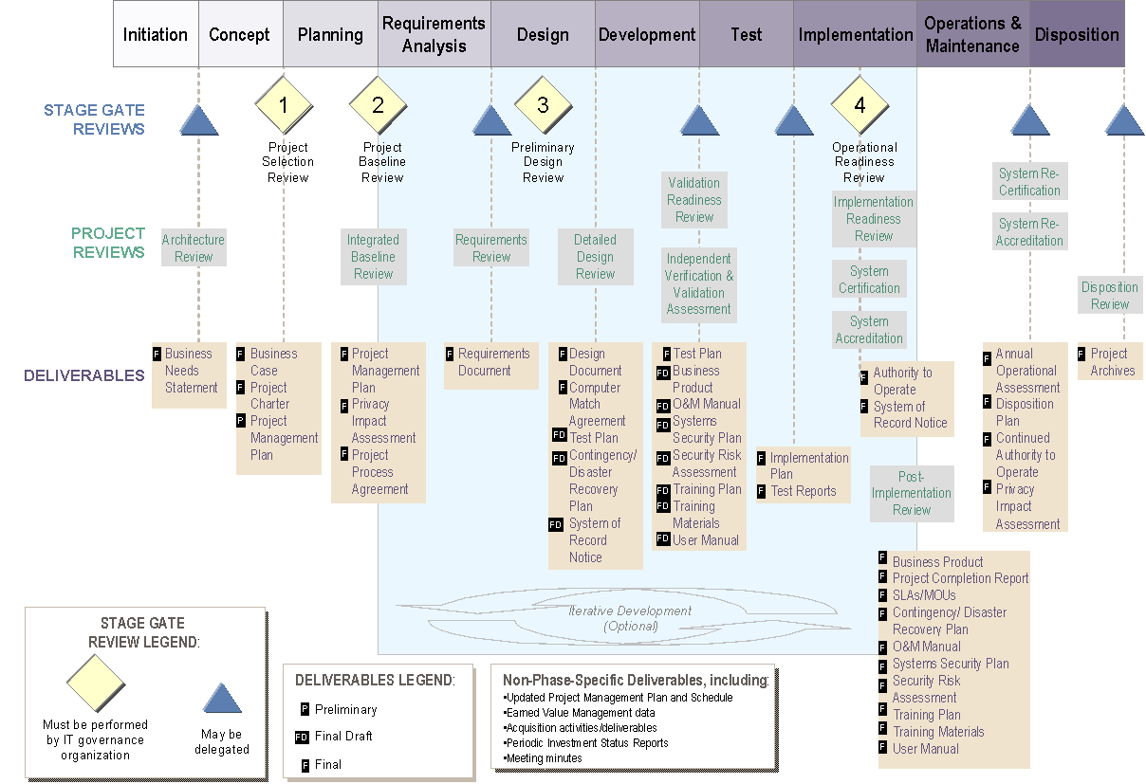
What’s a LifeCycle? (HHS)
Notes:
The EPLC framework provides a guide to Project Managers, Business Owners, IT Governance Executives, other Stakeholders, and Critical Partners throughout the life of the project.
Critical partners are required to ensure maximum IT portfolio performance.

Slide 6
Making the call
Recommend
No issues OR
Issues have been remediated OR
Issues cannot be fixed and that’s OK (exception, remediation plan)
Recommend with Conditions
Issues, but the Project is working on it.
Should be phrased as “X” will be done by “DATE”.
Not Recommended
Presents a clear and significant risk to the agency and the project is not working on the issues.

Slide 7
Classic Development LifeCycle– “Waterfall”
Recognize need
Define the problem
Design a solution to the problem
Analyze and validate the design
Built to specific design
Test to specifications
Deploy system
Bugfix & maintenance
Retire system

Slide 8
Modern Development LifeCycle– “Iterative”
Identify the overarching requirements and basic need.
Develop:
Define a part of the problem
Build a solution to that part of the problem
Does it solve that part of the problem?
No – go back and rebuild.
Yes – deploy that, then define another part and build that out.
Repeat until as much of the problem is solved as resources allow.
Bugfix & maintenance
Retire system

Slide 9
Modern Development Types
Agile: emphasis on the business needs and constant realignment.
Scrum: “build fast, fail fast”: development in very short “sprints”, with multiple releases.
Lean Agile: hybrid of iterative development after more classic requirements gathering
Developers must validate accessibility during each interation!
DevOps: Emphasis on embedded dev teams who building just the pieces needed.
I call this the “Lego” approach.
User Interface components must be validated when built!

Slide 10
Modern 508
Ensure the Project Team have WCAG checklists in hand
Evaluate the Sprint/Iteration plan for dealing with 508. You’re looking for:
508 checks within the dev cycle, not just a “508 test” at the end
Adherence to standards (e.g. WCAG 2.0, HTML5)
508 SME/partners to do end-of-sprint validation.
For large projects, You’ll end up needing to create validation “Check Points” after a number of sprints to ensure it’s still accessible

Slide 11
Why Authoring Tools Matter
With rapid development occurring by multiple developers, the 508 SME can’t be everywhere.
Code management, accountability, and QA are essential to accessibility.
Development Environments are necessary, not just fancy text editors!
Some COTS platforms are not accessible, and the devs will not be able to make them so.
508 should evaluate the tools/platforms being used to build the system BEFORE development starts.
O – and it’s the law. [new 508 standards]

Slide 12
Validation of 508 Conformance
Overriding principle: you write it, you write it accessibly!
With the move away from detailed design, developers are responsible for validating accessibility in every line of code they write.
First Validation: Is it Valid Code?
To test: depends on the authoring tool. Most mature IDEs have plugins that can help.

Slide 13
Validation of 508 Conformance
Second Validation: Is the output accessible?
Automated tools can help here to find and manage issues
Third Validation: Manual testing
Keyboard navigation, color contrast, and focus trap testing.
Assistive Technology validation by a trained tester.
For enterprise projects:
An additional “test Sprint” to do formal testing before a major release.

Slide 14
Why Mobile is Different
Mobile app “projects” often happen informally.
Find out who owns the keys to your agency’s account on Google Play and the Apple Store!
Since they are not being deployed on the network, there is often no formal reviews or engagement.
If no policy/process exists for mobile app clearance, its time to begin one, including 508 clearance.
There are three types of mobile apps:
Web apps: repackage the website info.
Hybrid Apps: native apps that serve up HTML5 content and interaction
True Native: apps that allow login and secure data.

Slide 15
Mobile App Considerations
The Authoring tool matters!
For Web and Hybrid, code HTML5 to WCAG standards.
For Hybrid and True Native: Code to device standards (Android or IOS, as appropriate).
Acceptance Testing has to be done on an actual device.

Slide 16
Integrating Section 508 into the Development LifeCycle
MARK D. URBAN
CDC SECTION 508 COORDINATOR
FKA2@CDC.GOV

